Slide 1
Integrated Literacy Assignment
Emily Ringquist

Slide 2
G.L.C.E
1 – G1.0.1 Construct simple maps of the classroom to demonstrate aerial perspectives.

Slide 3
Maps
Teachers can show the students where their town is on the atlas pointing out landmarks of their town.

Slide 4
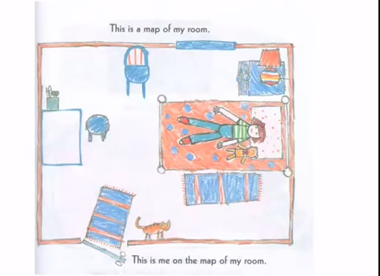
Books
Me and the Map written by Joan Sweeney
In this book, the main character describes locations around her and draws aerial maps of them. Students can be introduced to aerial maps through this book.

Slide 5
Books
Follow That Map! Introduces map terminology and gives aerial views of various community areas.
http://books.google.com/books?id=PJtMNw2x9nwC&printsec=frontcover&source=gbs_ge_summary_r&cad=0#v=onepage&q&f=false

Slide 6
Books
Uses maps of fairy-tale stories that students will be familiar with.

Slide 7
Songs
On The Map
There was a girl up in her room
She drew a map of her room
She was on the map
She had her own special place on the map
Then on a map she drew her house
She drew a map of her house
With her room in the house
She had her own special place on the map
Then on a map she drew her street
She drew a map of her street
With her house on the street
And her room in the house
She had her own special place on the map
http://www.songsforteaching.com/socialstudies/geography/onthemap.php

Slide 8
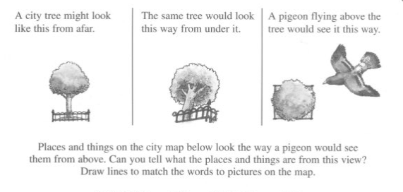
Activity Book
This book offers teachers activity pages and ideas on how to introduce mapping.

Slide 9
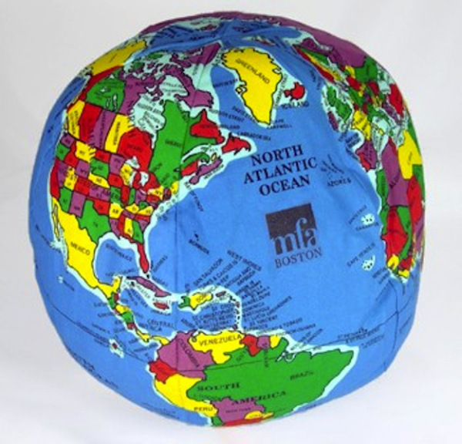
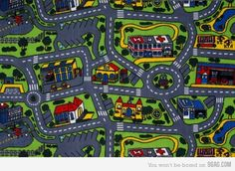
Games
The teacher can have a group of students find various locations with this aerial perspective.
Students can play quiet ball with this foam globe before the unit to begin to see an aerial perspective.

Slide 10
Websites
Google Earth – Bird’s Eye view
https://www.google.com/earth/
Mapquest
http://www.mapquest.com/satellite-maps/

Slide 11
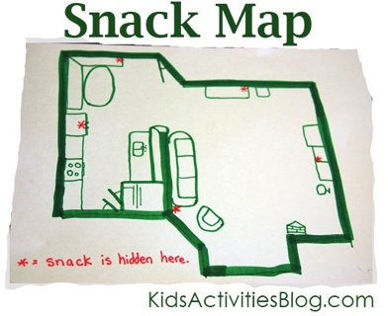
Lesson Plan
The teacher can make a map of the classroom and students can find the “X” locations.
Students then can make their own treasure maps of the classroom and trade with other students.

Slide 12
Lesson Plan
In this lesson, the students each get a penny and describe the different views of the penny and draw them. Then they can describes the differences and similarities.
http://www.eup.k12.mi.us/Page/1335
http://scope.oakland.k12.mi.us/docs/SS/SS010300/SS01030101_Supplemental_Materials.doc

Slide 13
Map Jokes
Q: Why does the Yeti know all the map symbols?
A: Because he's a legend.
Q: What kind of maps do spiders make?
A: Web-based maps.
Q: Why are maps like fish?
A: Both have scales.

Slide 14
Poetry
Directions to Nowhere
I was takin' a trip the other day
When I got confused about which way
I was to turn so in nothin' flat
I found I was lost, and needed a map.
Which way is north?
What's the Scale?
What does THIS mean?
You know our world is mostly round
But maps are flat and so I found,
That things don't look like they really are
Whether you're in a plane, a ship or a car.
When something round gets flattened out, you get distortion.
As I tried to make some sense of things
I saw stars and squares and little flat rings
I finally found an "N" which meant of course.....
So I twisted the map 'til things looked right.....
Well I got un-lost and finished my trip.
But I'd like to share this little tip......
You need to look at the scale and key.....

Slide 15
Video
http://www.youtube.com/watch?v=NSw1F-E_M2A

Slide 16
Citations
Sweeny, J. (1996). Me on the Map. New York, NY: Grown Publishers. http://www.amazon.com/Map-Dragonfly-Books-Joan-Sweeney/dp/0517885573
Jones, S. On the Map. On Songs About Popular Children’s Books [CD]. http://www.songsforteaching.com/socialstudies/geography/onthemap.php
Tamblyn, C. (2002). Map Skills Made Fun: Neighborhoods and Communities. Teaching Resources. http://www.amazon.com/Map-Skills-Made-Fun-Neighborhoods/dp/0439296439
Cullen, G. (2013) http://redtri.com/mad-about-maps/slide/8/#slide
Kids Activities Blog. 28 Mar. 2012. Web. http://kidsactivitiesblog.com/3700/map-skills-activity
Google Earth (2014). Google Maps. https://www.google.com/earth/
Neighborhood Map http://9gag.com/gag/291790
Dora the Explorer (2000- 2014). Youtube. http://www.youtube.com/watch?v=NSw1F-E_M2A
Ritchie, S. (2009). Follow That Map. Tonawanda, NY: Kids Can Press. http://books.google.com/books?id=PJtMNw2x9nwC&printsec=frontcover&source=gbs_ge_summary_r&cad=0#v=onepage&q&f=false

Slide 17
Citations Continued
Maute, J. “Directions to Nowhere.” Unfolding Maps. http://songsforteaching.com/geography/howtoreadamap/directionstonowhere.htm
Delorme Mapping Company (2012). Michigan Atlas & Gazetteer. Online. Retrieved October 4,2014. from http://www.amazon.com/Michigan-Gazetteer-Delorme-Mapping-Company/dp/0899333354
Maps and Aerial Views. Mapquest. http://www.mapquest.com/satellite-maps/
Caldwell, D. Mape Jokes. In About Geography. Retrieved November 12, 2014. http://geography.about.com/library/misc/blhumor9.htm
Unit 3: How Do We Learn About Places (2011, June 22). In Eastern Upper Peninsula ISD. Retrieved November 12, 2014. http://www.eup.k12.mi.us/Page/1335
Hennessy, B. G (2010). The Once Upon a Time Map Book. Candlewick Press. http://books.google.com/books/about/The_Once_Upon_a_Time_Map_Book.html?id=OgawQAAACAAJ

